Slide 1

PREDICTING IN-HOSPITAL MORTALITY
WITH MACHINE LEARNING
JOSHUA LUDOLF
AI 395T - AI IN HEALTHCARE
UNIVERSITY OF TEXAS AT AUSTIN
Notes:
https://colab.research.google.com/drive/1gT7C6faQTgdsRS-PBf5WlEkQz-rpS_bl?usp=sharing

Slide 2

THE PROBLEM?
In-hospital mortality is a critical outcome in healthcare. Predicting which patients are at high risk of mortality upon admission or during their stay can allow healthcare providers to intervene earlier, allocate resources more effectively, and potentially improve patient outcomes. A predictive model could be used for risk stratification, guiding clinical decision-making, and identifying patients who may benefit from more intensive monitoring or specific interventions.
Notes:
To address this problem, we will primarily use the following datasets:
ADMISSIONS: This dataset contains crucial information about each hospital admission, including the HOSPITAL_EXPIRE_FLAG, which directly indicates in-hospital mortality. It also provides admission and discharge times, admission type, and initial diagnoses, which can be valuable features for prediction.
PATIENTS: This dataset contains patient demographic information, such as age and gender, which are important factors influencing mortality risk.
ICUSTAYS: While not strictly necessary for in-hospital mortality as defined by ADMISSIONS, this dataset provides information about ICU stays, which are often associated with higher acuity and risk. Features from this dataset, such as length of ICU stay or first/last care unit, could potentially improve the predictive model, although we will focus on features available at admission initially.
DIAGNOSES_ICD: This dataset links admissions to ICD-9 diagnosis codes. By utilizing this data in conjunction with D_ICD_DIAGNOSES, we can incorporate the patient's diagnoses as features, which are strong indicators of their health status and potential mortality risk.
D_ICD_DIAGNOSES: This is a lookup table that provides the full title for the ICD-9 codes found in DIAGNOSES_ICD. This will be used to understand and potentially group diagnoses for feature engineering.
We will focus on features available at or near the time of admission to build a predictive model that can be used for early risk assessment.

Slide 3
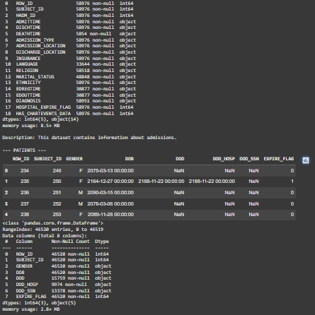
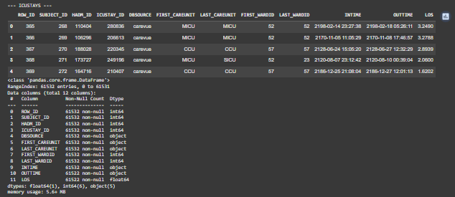
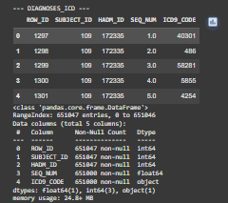
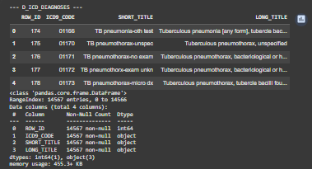
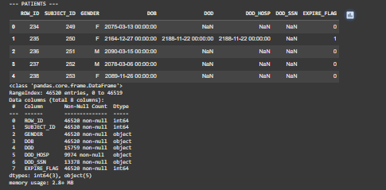
DATA EXPLORATION
Notes:
Primary Datasets to be Used:
To address this problem, we will primarily use the following datasets:
ADMISSIONS: This dataset contains crucial information about each hospital admission, including the HOSPITAL_EXPIRE_FLAG, which directly indicates in-hospital mortality. It also provides admission and discharge times, admission type, and initial diagnoses, which can be valuable features for prediction.
PATIENTS: This dataset contains patient demographic information, such as age and gender, which are important factors influencing mortality risk.
ICUSTAYS: While not strictly necessary for in-hospital mortality as defined by ADMISSIONS, this dataset provides information about ICU stays, which are often associated with higher acuity and risk. Features from this dataset, such as length of ICU stay or first/last care unit, could potentially improve the predictive model, although we will focus on features available at admission initially.
DIAGNOSES_ICD: This dataset links admissions to ICD-9 diagnosis codes. By utilizing this data in conjunction with D_ICD_DIAGNOSES, we can incorporate the patient's diagnoses as features, which are strong indicators of their health status and potential mortality risk.
D_ICD_DIAGNOSES: This is a lookup table that provides the full title for the ICD-9 codes found in DIAGNOSES_ICD. This will be used to understand and potentially group diagnoses for feature engineering.

Slide 4
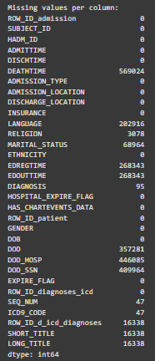
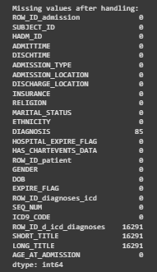
PREPROCESSING THE DATA
AFTER INITIAL EXPLORATION IT WAS CLEAR THAT SOME OF THE DATA WAS MISSING (NULL VAULES) FOR THE ICD9_CODES, DIAGONOSIS, AND SEQUENCE NUMBERS. THUS TO HANDLE THIS EITHER DROPPING THE COLUMN OR FILL IT WITH A DEFAULT VALUE

Slide 5
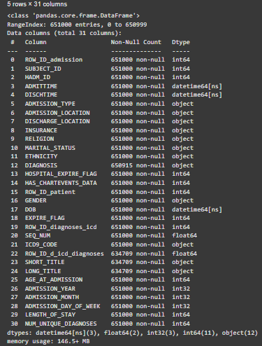
FEATURE ENGINEERING
CREATED NEW FEATURES FROM THE RAW DATA THAT CAN IMPROVE THE PERFORMANCE OF THE MODEL(S). THIS INVOLVED TIME-SERIES ANALYSIS, AGGREGATING DATA, AND CREATING CATEGORICAL VARIABLES.

Slide 6
Based on the defined problem of predicting in-hospital mortality, which is a binary classification task, and the nature of our data (a mix of numerical and categorical features, including engineered features and potentially a large number of diagnosis-related features), Iconsidered the following machine learning models:
Logistic Regression:
Rationale: Logistic Regression is a simple yet powerful linear model for binary classification. It provides interpretable results (coefficients can be interpreted as the change in the log-odds of the outcome for a one-unit change in the predictor). It is computationally efficient and can serve as a good baseline model.
Strengths: Interpretability, speed, good performance on linearly separable data.
Weaknesses: Assumes a linear relationship between features and the log-odds of the outcome, may not capture complex non-linear relationships.
Gradient Boosting (e.g., LightGBM or XGBoost):
Rationale: Gradient Boosting models are ensemble methods that combine multiple weak learners (typically decision trees) to create a strong predictive model. They are known for their high accuracy and ability to handle complex non-linear relationships and interactions between features. They are often top performers in tabular data competitions.
Strengths: High accuracy, handles non-linearities and interactions well, robust to different types of features.
Weaknesses: Can be prone to overfitting if not tuned properly, less interpretable than linear models.
Random Forest:
Rationale: Random Forest is another ensemble method that builds multiple decision trees and aggregates their predictions. It is less sensitive to hyperparameters than Gradient Boosting and provides a measure of feature importance, which can be useful for understanding the model's decisions.
Strengths: Good accuracy, less prone to overfitting than single decision trees, provides feature importance, handles various feature types.
Weaknesses: Can be computationally more expensive than Logistic Regression, less interpretable than linear models.
Model(s) Selection
Notes:
Considerations for Class Imbalance:
In-hospital mortality is likely to be a rare event compared to survival, leading to a class imbalance problem (significantly fewer positive examples of mortality than negative examples of survival). This can bias models towards predicting the majority class (survival), resulting in poor performance on the minority class (mortality). To address this, we will consider techniques such as:
Using appropriate evaluation metrics: Instead of relying solely on accuracy, we will use metrics like precision, recall, F1-score, and AUC-ROC, which are more informative for imbalanced datasets.
Resampling techniques:
Oversampling the minority class: Duplicating examples from the minority class (e.g., using SMOTE - Synthetic Minority Over-sampling Technique) to balance the class distribution.
Undersampling the majority class: Removing examples from the majority class.
Using class weights: Many ML algorithms allow assigning higher weights to the minority class during training to penalize misclassifications of the minority class more heavily.

Slide 7
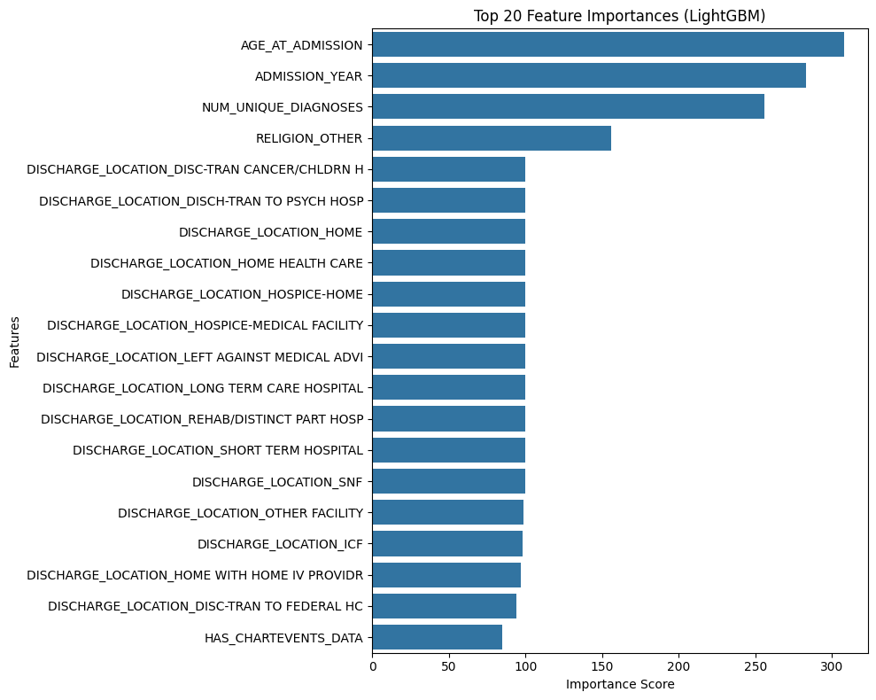
MODEL TRAINING AND EVALUATION
Notes:
When evaluating models for an imbalanced dataset like in-hospital mortality prediction, metrics like Accuracy can be misleading. A model that always predicts the majority class (survival) could have high accuracy but fail to identify any of the minority class (mortality). Therefore, we focus on Precision, Recall, F1-score, and especially AUC-ROC.
* **AUC-ROC:** This metric represents the model's ability to distinguish between the positive and negative classes across various probability thresholds. A higher AUC-ROC indicates better overall discriminatory power.
* **Precision:** Of all the patients the model *predicted* would die, what proportion actually died? High precision minimizes false positives (predicting death when the patient survives). This is important to avoid unnecessary distress or interventions.
* **Recall:** Of all the patients who *actually* died, what proportion did the model correctly identify? High recall minimizes false negatives (failing to predict death for a patient who dies). This is crucial in a healthcare setting to ensure high-risk patients are not missed.
* **F1-score:** The harmonic mean of precision and recall, providing a balance between the two.
Comparing the AUC-ROC values, we can see that LightGBM has the highest AUC-ROC (0.9942), followed closely by Random Forest (0.9934) and then Logistic Regression (0.9895). This suggests that LightGBM has the best overall ability to discriminate between patients who will and will not experience in-hospital mortality.
Looking at Precision and Recall, there is often a trade-off. LightGBM achieves a good balance with a high F1-score (0.8922), a relatively high Recall (0.8557) meaning it identifies a large proportion of actual deaths, and a strong Precision (0.9319) meaning its positive predictions are highly reliable. Random Forest has slightly higher Precision (0.9503) but lower Recall (0.8108), meaning it is more conservative in predicting death but misses more actual deaths. Logistic Regression has the lowest Precision and Recall among the three. In the context of predicting in-hospital mortality, the relative importance of precision and recall depends on the clinical application. If the goal is to identify a small group of high-risk patients for intensive intervention (where resources are limited), high precision might be preferred to minimize unnecessary interventions. If the goal is to screen a large population to ensure no high-risk patient is missed (even at the cost of some false positives), high recall might be more important. LightGBM strikes a strong balance between Precision and Recall, making it a potentially suitable model for various clinical goals.
Overall, LightGBM appears to be the best performing model based on its superior AUC-ROC and a strong balance between Precision and Recall as indicated by its high F1-score.

Slide 8
NEXT STEPS
While the models achieved high performance metrics, the persistence of very high scores even after removing apparent leakage suggests a need for further rigorous investigation into potential subtle data leakage or re-evaluation of the feature set based on strict clinical availability at the time of prediction.
Future work should explore incorporating dynamic, time-series data from MIMIC-III (like vital signs or lab results) to capture changes in patient condition during hospitalization, which could potentially improve the predictive power of the models beyond admission-time features.

Slide 9

THANK YOU

